Slide 1
html tags
MCNDHS
Ms. Eng

Slide 2
aim: Forms-Radio buttons
Do now:
Daily Grade:
On-time/attendance/not leaving the classroom: 25%
Cellphones: 25%
Notes:25%
Classwork/Homework: 25%

Slide 3

surveys

Slide 4
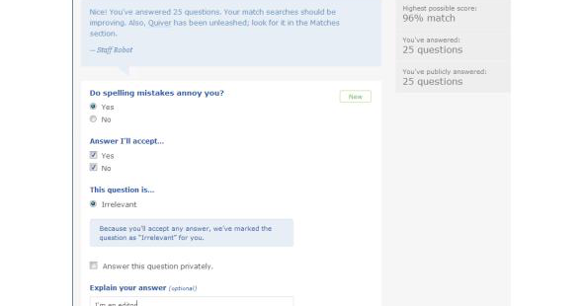



another example:

Slide 5
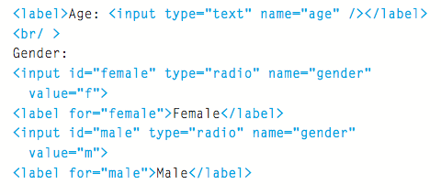


Slide 6
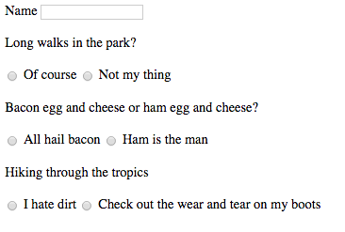
activity
make a fake dating website form:

